Slide 1

HUDAG x HBC x SouthPole
Final Presentation
1/26
Case Team Leads
Andy Kim, William Zhang
Associate
Theo Datta
Analysts
Lucy Jiao, Brandon Kim, Eli Kirtley, Justin Liu
Shelly Liu, Henry Xuan, Gary Wu

Slide 2



We identified reliability, transparency, and long-term cost efficiency as key value propositions that blockchain technology could offer.
Inefficiencies in the carbon credit market
How blockchain technology can help
!
Unreliable verification
No standardized regulation
High Costs
Increases reliability
Makes transactions more transparent
Lowers overhead costs
$$$
-$
Notes:
Identified 3 inefficiencies in the carbon credit market : unreliable verification systems, which could be a result of no standardardized regulation as there are several organizations with differing standards, and the high costs of this system with human validation.
Blockchain can improve these areas as it increases reliability, increases transparency as all transaction history is available and any verification is automatically be traced to the source, and it reduces overhead costs from the automation

Slide 3
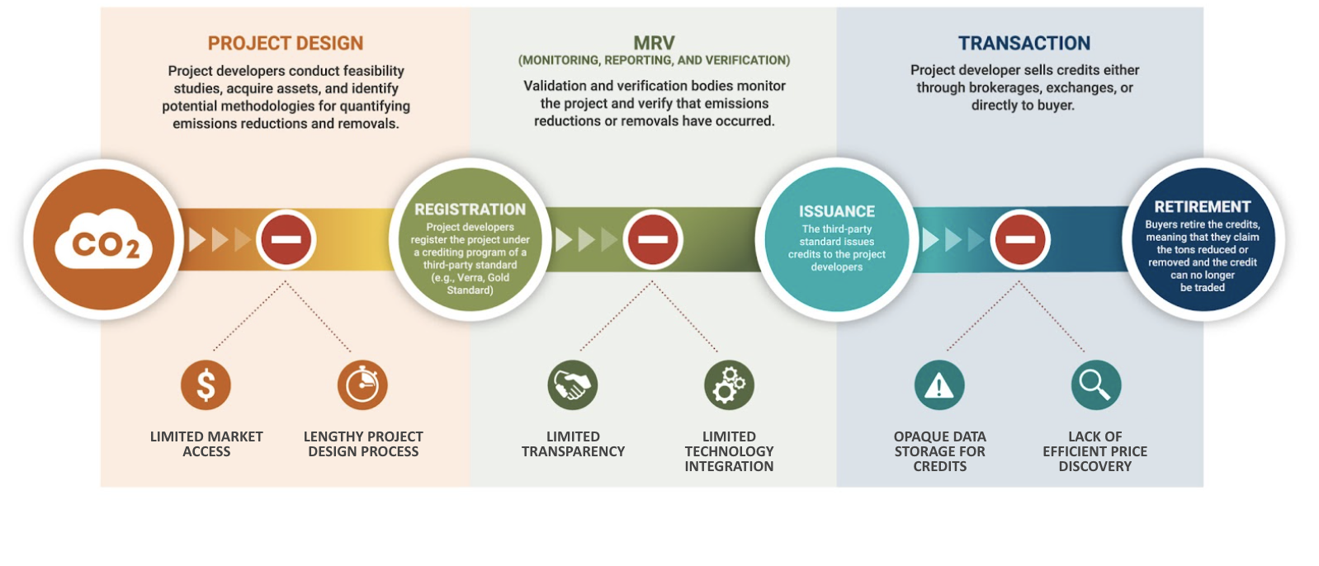
After considering three potential entry points, we identified data storage as the most advantageous for blockchain adoption.
Notes:
Theo
Values - decentralization, immutability, transparency

Slide 4
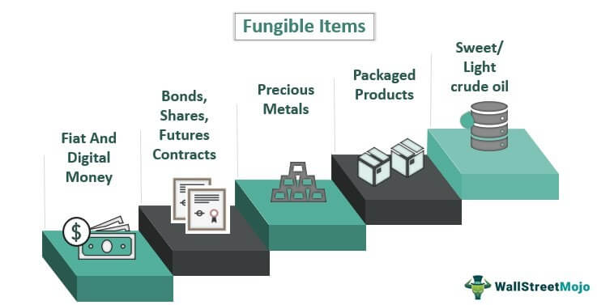
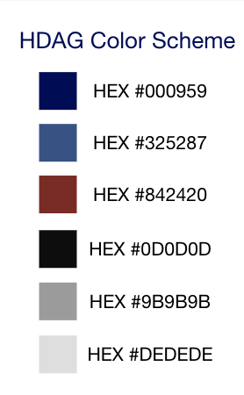
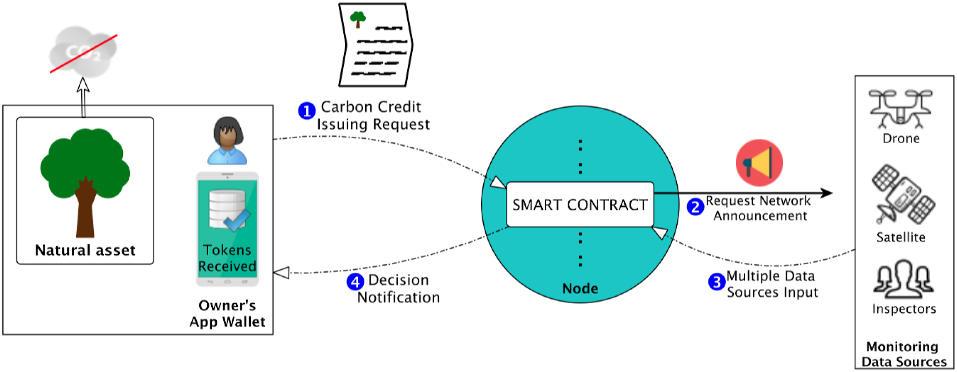
We identified a number of issues with the potential entry points of creating carbon credit-based tokens and automated on-chain verification.
Creating Carbon Credit-Based Tokens:
Several existing solutions - may not be great added value in another similar solution
Difficult to capture heterogeneity of projects
Potentially perverse incentives to underestimate costs
Automated On-Chain Verification:
Difficult to account for important heterogeneous and qualitative factors
Insufficient maturity of IoT technologies
Not enough standardized data/factors to evaluate projects reliably
Notes:
Theo
Talk about forestry in the issues

Slide 5

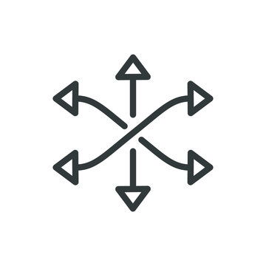

Using blockchain to improve storage will address currently opaque data storage for carbon credit projects.
Tamper-Proof
Data is decentralized, encrypted and immutable, protecting it from hackers or unauthorized changes
Versatile
Information necessary for verification can be acquired by non-blockchain means, but stored in a blockchain database
Transparent
Transactions and exchanges are created on public ledger, so public can oversee and verify transactions
Notes:
For our recommendation, it is most advantageous to use blockchain to address the currently opaque data storage for carbon credit projects
Tamper-Proof: Data is decentralized, encrypted and immutable, protecting it from hackers or unauthorized changes
Versatile: Information necessary for verification can be acquired by non-blockchain means, but stored in a blockchain database
Transparent: Transactions and exchanges are created on public ledger, so public can oversee and verify transactions
This is especially advantageous in the carbon credits market, which is relatively new and lacks a robust structure, meaning that data is often unreliable and prices are arbitrarily set.

Slide 6

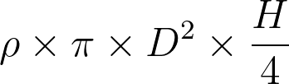
Dummy Forestry Data Generation Process
Motivation
Creating a dataset of dummy forestry carbon offset projects to be stored on-chain on the proof-of-concept.
Methodology
Generated 1000 plots of 10 trees each
Sampled normal distributions to generate data points in variables such as plot area, coordinates, heights and diameters from normal distributions
Calculated predicted above ground biomass by species from below equation (⍴: wood density, D: diameter, H: height)
Notes:
For the proof-of concept we created some dummy forestry data which I will briefly explain
We generated 1000 dummy plots, each of which contained 10 trees
Each plot’s area was sampled from a normal distribution centered at approximately 800 square meters
Latitude for each plot was sampled from a truncated normal cut off at -90 and 90
Longitudes were sampled from a uniform distribution ranging from 0 to 180 degrees
For each tree, its’ height and diameter were sampled from species specific normal distributions
and its’ predicted above ground biomass is calculated as a function of its’ height, diameter, and wood density ρ (based on species), using the following formula:

Slide 7
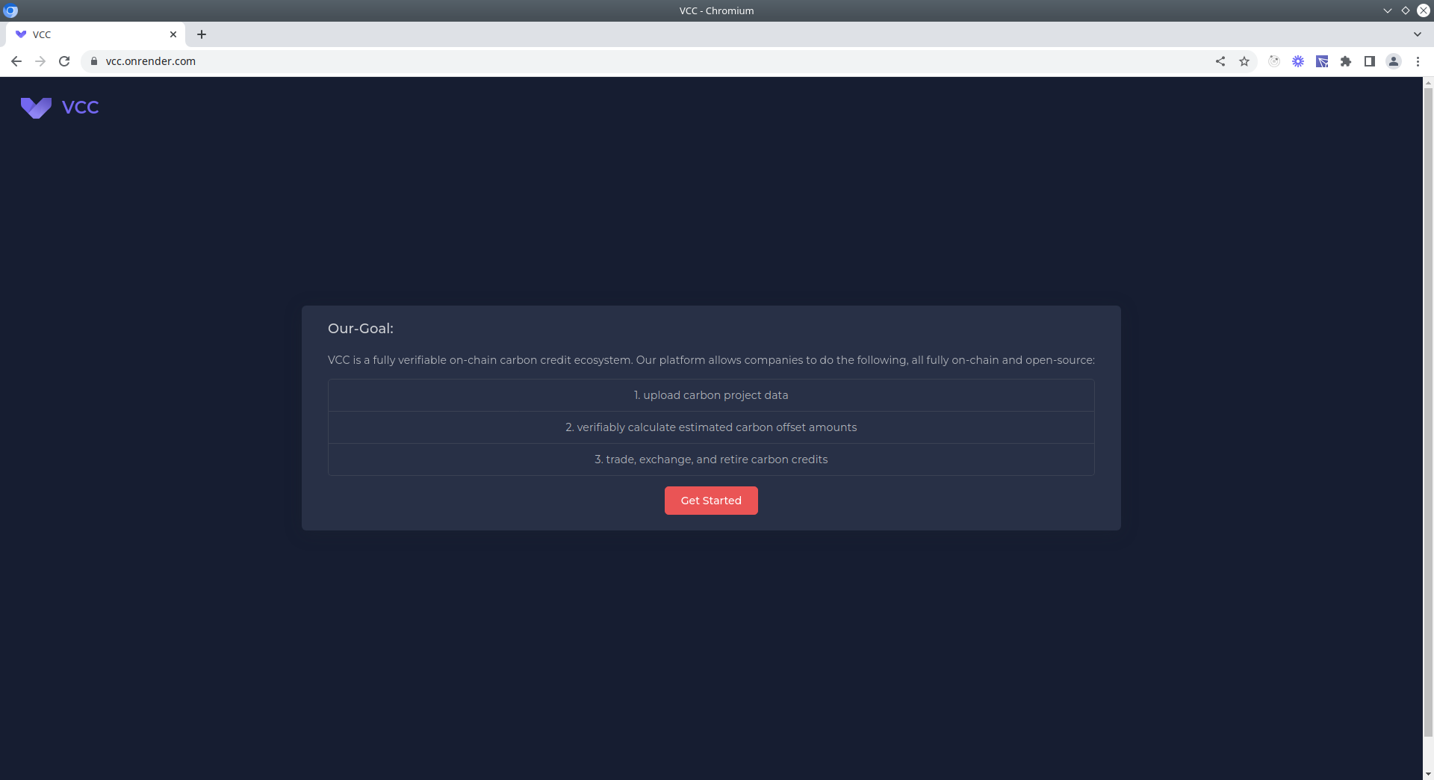
Solution: Fully Verifiable On-chain Carbon Credit Ecosystem
Notes:
Mention data collection + south pole feedback

Slide 8
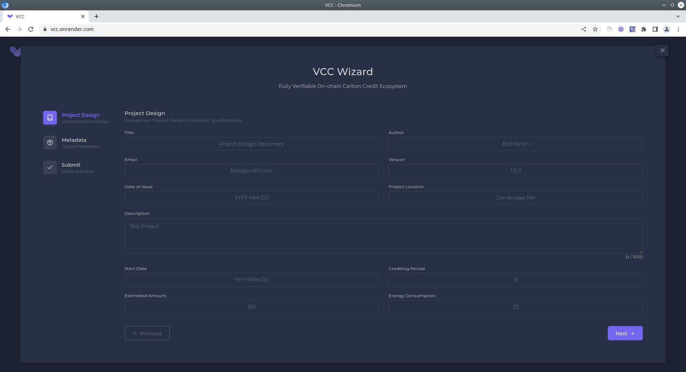
Solution: Fully Verifiable On-chain Carbon Credit Ecosystem
Step 1:
Companies upload their project design document specifications.
Advantages:
Instead of PDF files, specific properties chosen for space efficiency.
Data all uploaded to IPFS = fully decentralized and open source.
Notes:
Probably before this page is a “homepage”, outlining the steps to use the platform and a “get started” button.
Regarding this page, Input form, call the /upload endpoint, remember the link that is returned

Slide 9
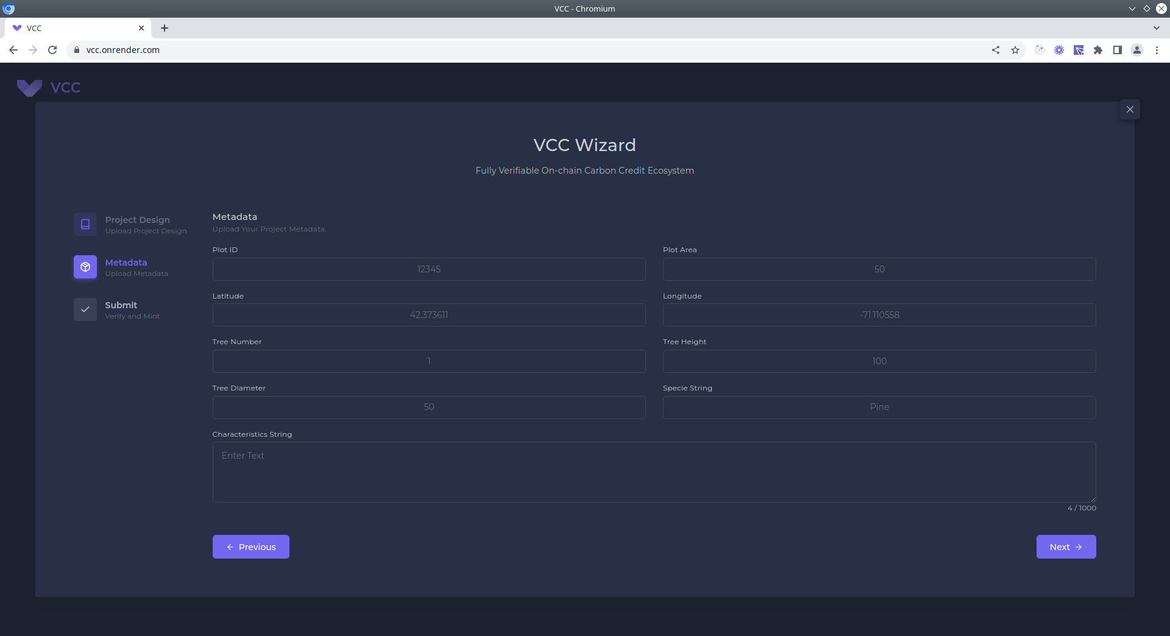
Solution: Fully Verifiable On-chain Carbon Credit Ecosystem
Step 2:
Companies upload their their project metadata.
Advantages:
Instead of PDF files, specific properties chosen for space efficiency.
Data all uploaded to IPFS = fully decentralized and open source.
In the future, IOT sensors will automate this process.
Notes:
Input form, call the /upload endpoint, remember the link that is returned

Slide 10
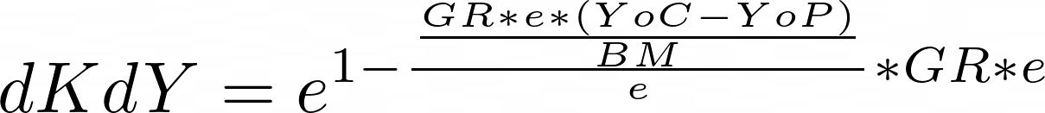
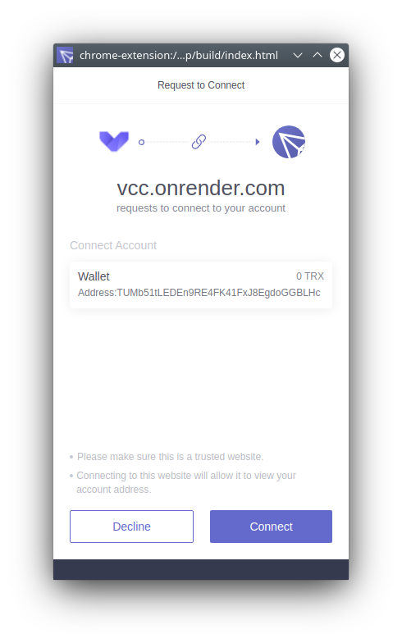
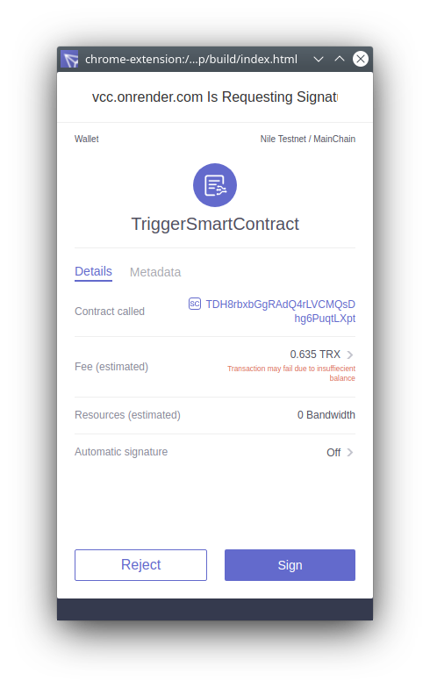
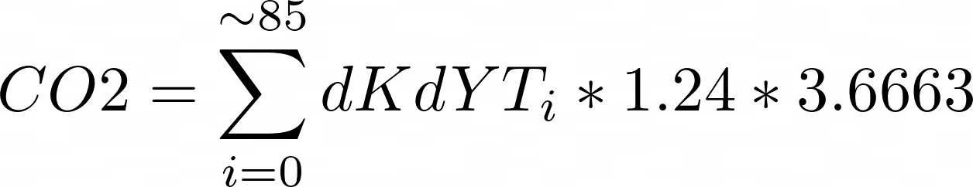
Solution: Fully Verifiable On-chain Carbon Credit Ecosystem
Step 3:
Companies interact with VCC token to verify carbon offset fully on-chain.
Smart contracts onto the Tron network use quantitative models to predict carbon offset.
Advantages:
Open and transparent carbon offset calculations.
Automatically credit fungible shares of VCC token to companies.
Sources: Chave et at (2001), Niklas and Enquist (2001), Cairns et al (1997), Kirby and Potvin (2007)
Notes:
Two buttons, one to connect the wallet, and the other to “verify on-chain”. The “verify on-chain” button will pass in the two links from ipfs returned from /upload, and an integer representing the tree diameter breast height (this should be taken in through an input element on this page). These three parameters (two strings and an int) will be passed to the smart contract, address TDH8rbxbGgRAdQ4rLVCMQsDhg6Puqt on the nile testnet for the Tron network, function “verify”. You can see the contract code on the repo.
LXpt
o

Slide 11


Solution: Fully Verifiable On-chain Carbon Credit Ecosystem
Step 4:
Clients can exchange VCC tokens in an open marketplace.
Smart contracts inherit the ERC20/TRC20 standard.
Advantages:
Fully tradable, standardized tokens
Notes:
NO PAGE NEEDED

Slide 12

Demo
Get Started
https://vcc.onrender.com/
Or watch the demo video!
https://www.loom.com/share/6799546b99744ccca98bb8feff701329

Slide 13
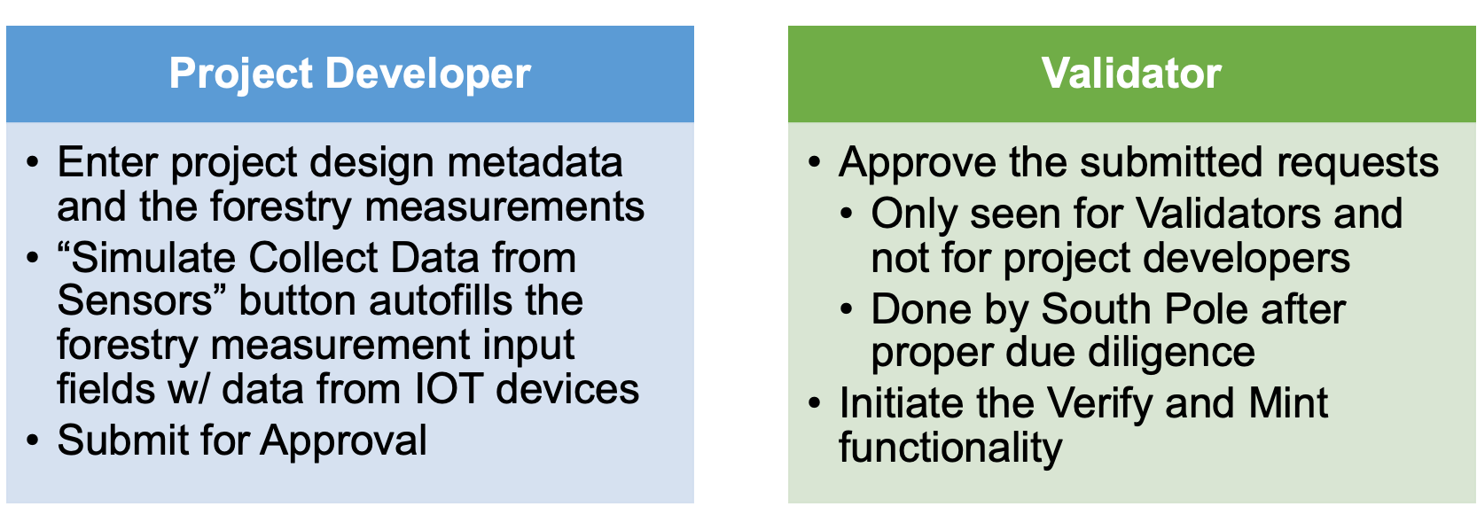
Login Ability
Notes:
NO PAGE NEEDED

Slide 14
Locking function
Carbon credits can be locked using an external function in the contract code
Developers submit a project report and the metadata as input in order to unlock a credit using the external function
The status of whether or not a carbon credit is locked is stored in a map within the contract code
Carbon credits are locked on creation, but if the same credit already exists, users can unlock them using the form
The specific effect of locking is to be determined by the South Pole team
Notes:
NO PAGE NEEDED

Slide 15
Retiring Carbon Credits
Developers can retire credits using the retire functionality within the contract
Upon creation, credits are not retired - the status of whether a carbon credit is retired is stored in the contract code
Given the different use cases of digital carbon credits at the moment, the fully verifiable nature of this blockchain solution allows anyone to verify that we have retired the given Carbon Credit
After retiring a credit, its relevant functionality is no longer usable, and has the same effect of retiring a carbon credit physically
Notes:
Lastly, we have the ability for developers to retire carbon credits using the smart contract code. Credits are not retired upon creation, and the code stores the status of whether a given credit is retired or not. Keeping in mind the different use cases of digital carbon credits, our solution allows anyone to verify who has retired which carbon credits.
This is important, as it can provide verifiable proof of who exactly has retired which carbon credit.

Slide 16
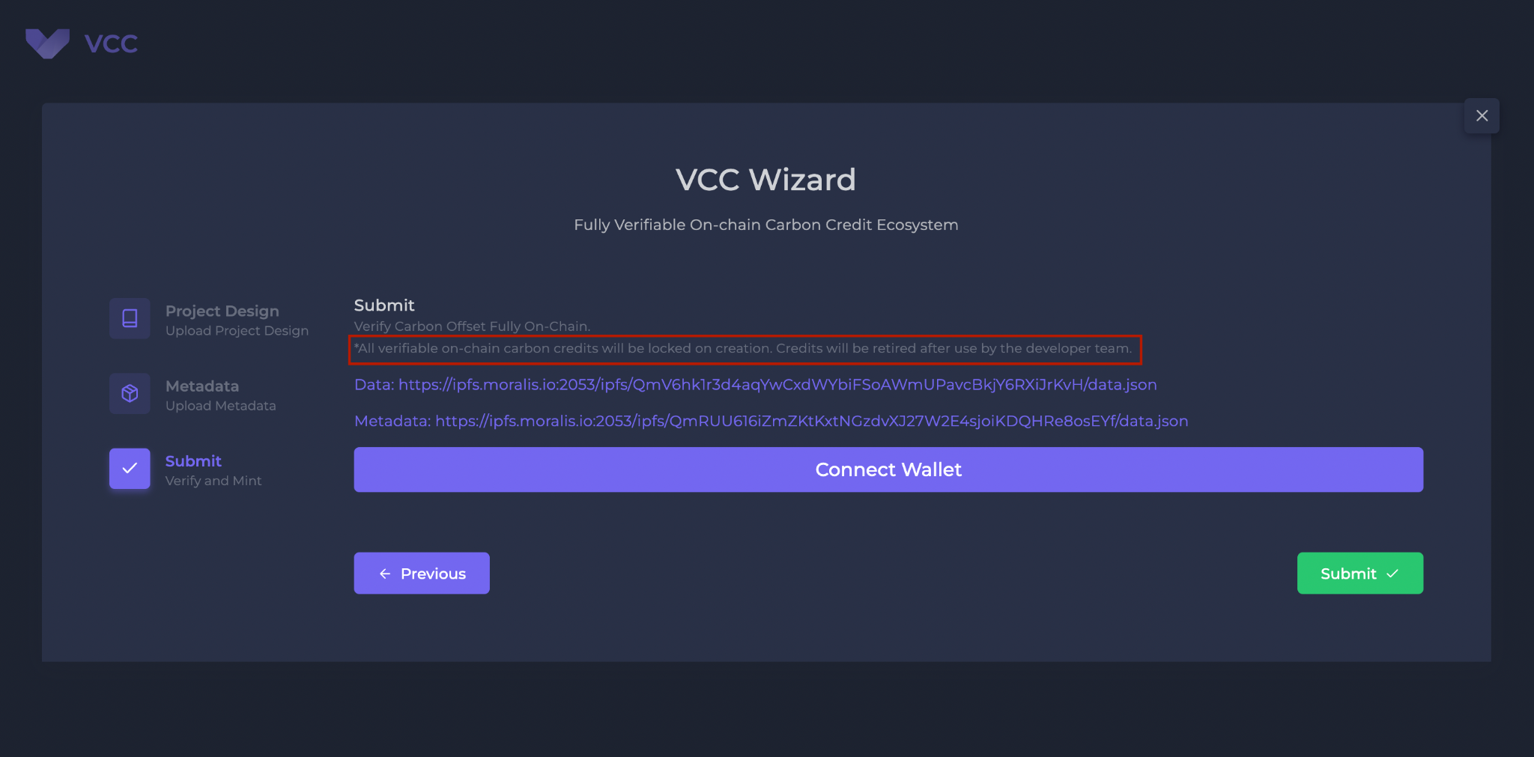

Slide 17
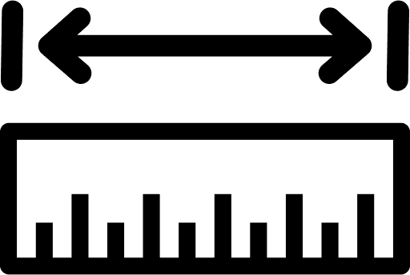



Demo Summary
Login for validator, have the ability to add measurements
Login for project developer, have the ability to upload “collect”
Locking credits and unlocking them every year based on new data
measurements
Retiring credits in a reliable and permanent way

Slide 18
Discussion

